Slide 1
Branding Yourself Through Social Media
JamyBechler.com @CoachBechler

Slide 16
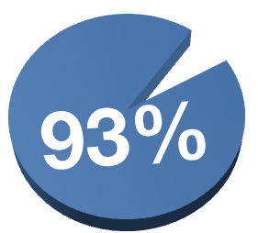

Slide 17
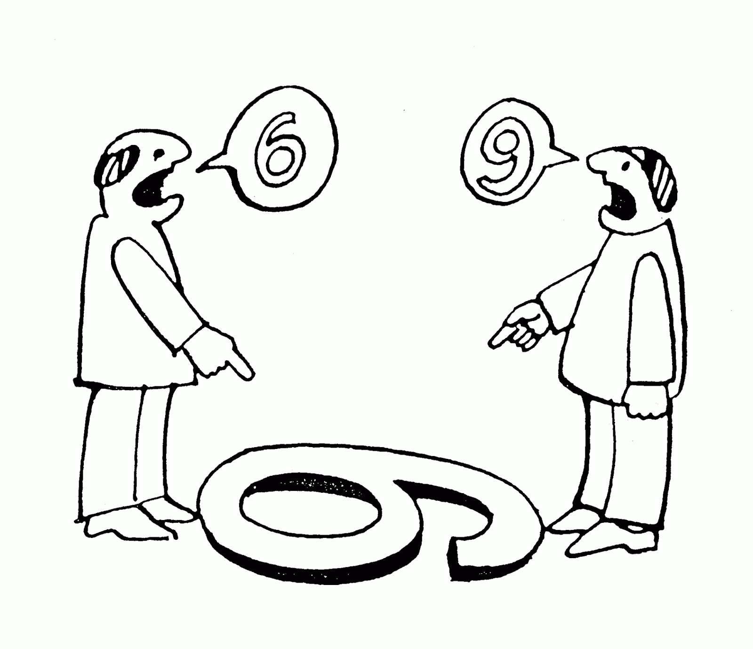

Slide 18
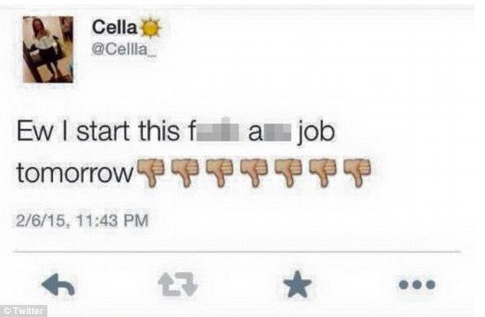

Slide 19
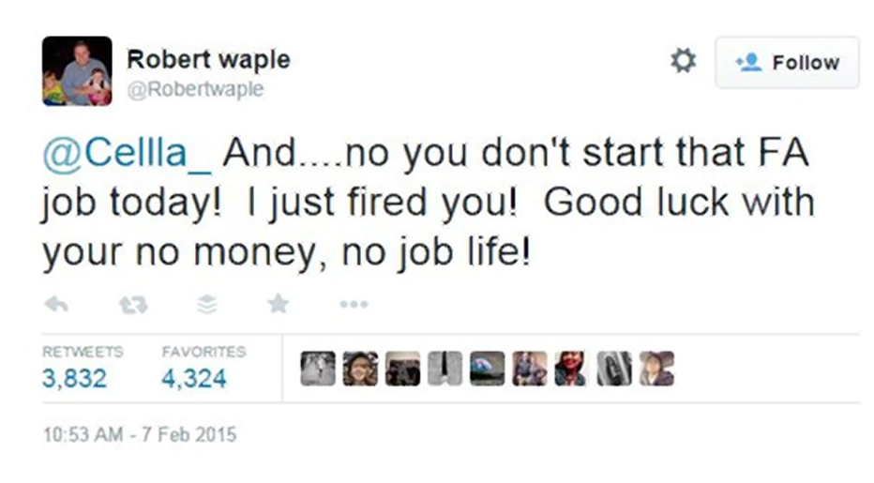

Slide 22
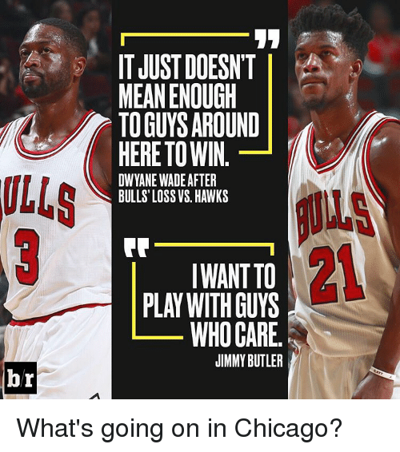

Slide 23
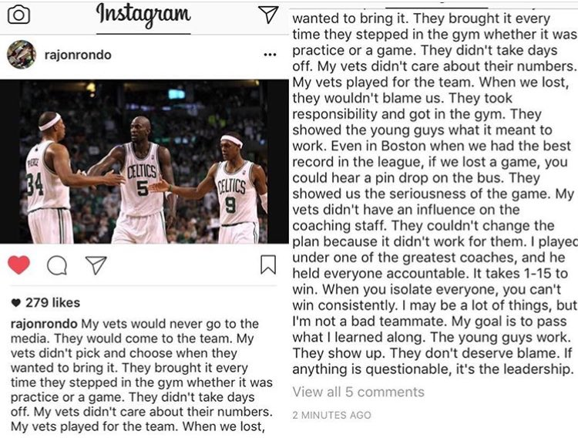

Slide 25
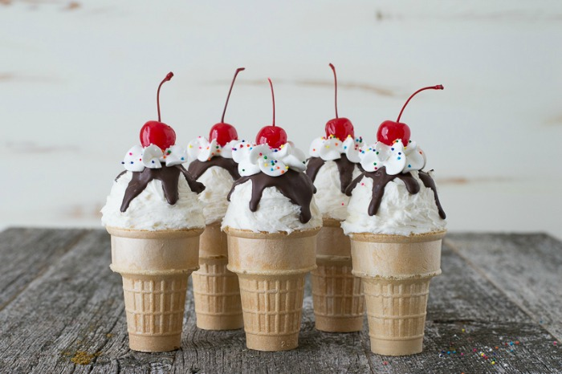

Slide 28
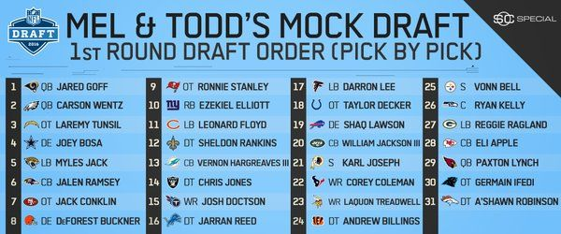
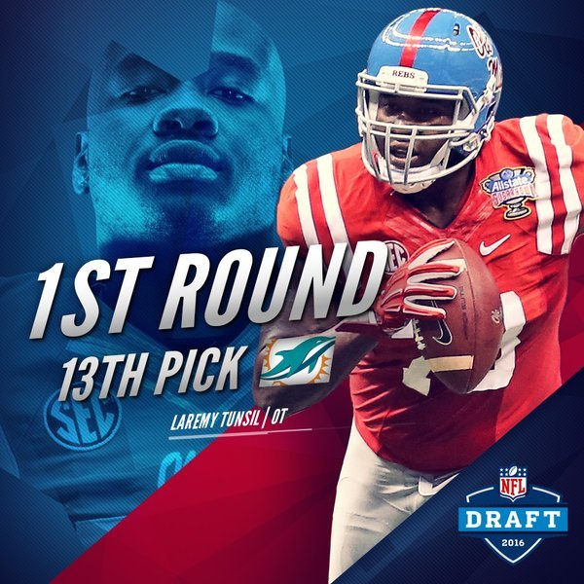
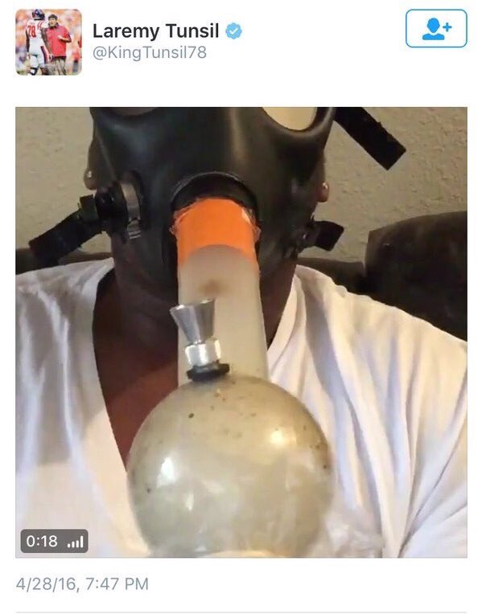

Slide 29
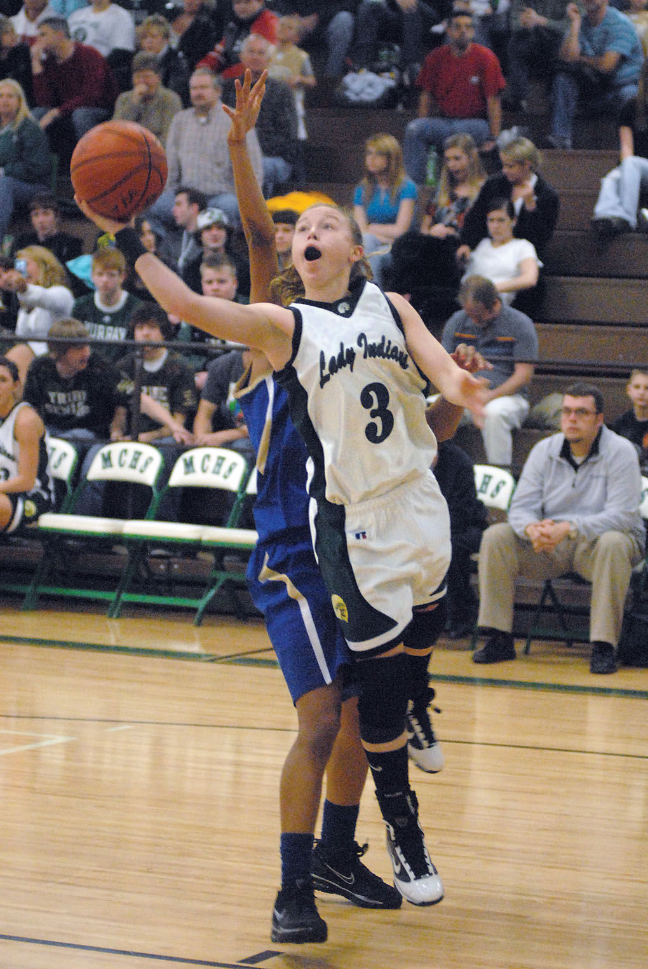
First tweet from the night states: @TemberMarchant3: Tonight is gonna be so good. Leggo! Imma be lookin fly as hell! #Holla@me
Next tweet from her better explains her night: @TemberMarchant3: Ohhhhh hell yeah. Party started. I got my drink and my 2 step.. Technically my WOP.
2 Tweets later must be after the damage happened: @TemberMarchant3: Probably the worst night of my life.

Slide 31
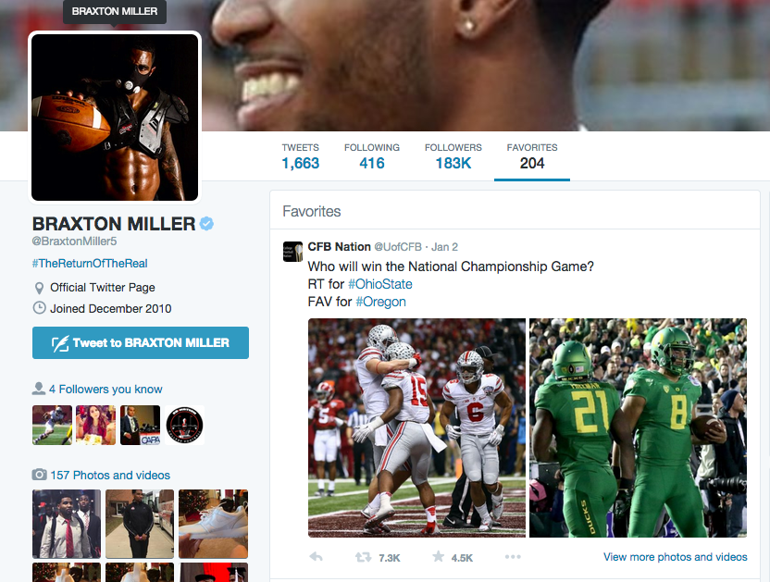

Slide 34
Consistently tell your story
Share your college mission statement and goals.
Identify your glorious moments and success stories.
Demonstrate the importance of team and loyalty to your coaches.
Everything you put on the internet is easily shared and therefore "permanent."
Understand the potential repercussions before sharing your opinions.
Carefully review any photos or videos you plan to post.
Use a communication coach to review your posts before they go live
Support others; Sportsmanship
Say ‘Thank You’

Slide 38
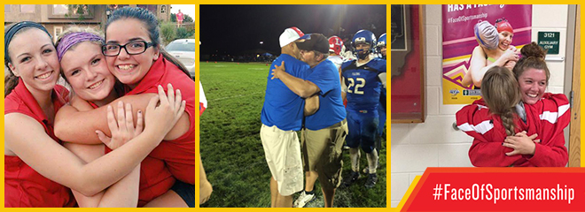

Slide 40
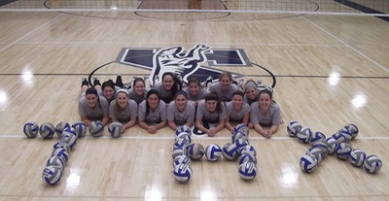
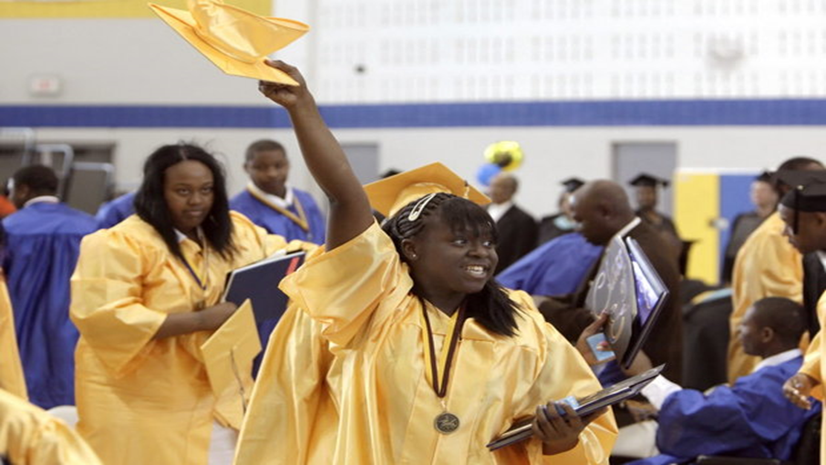
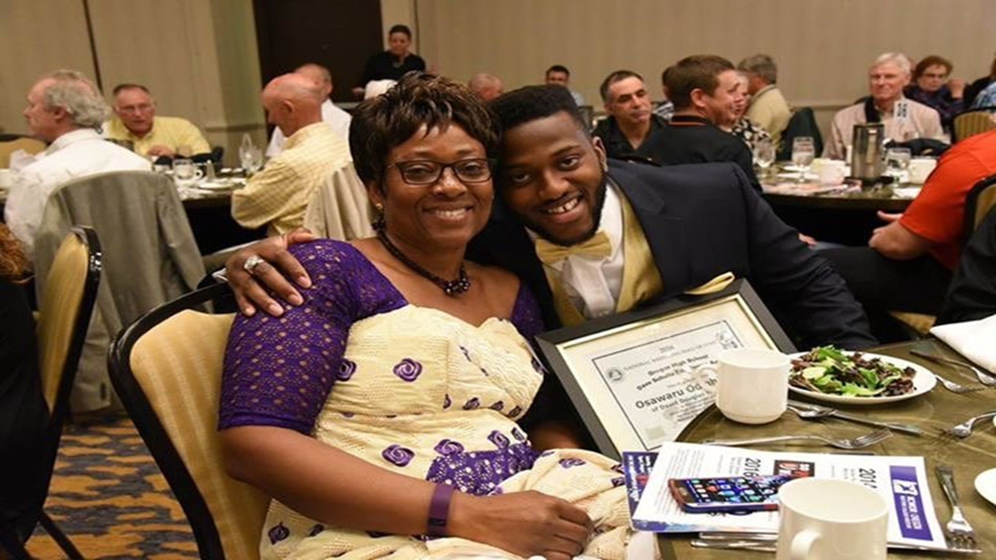
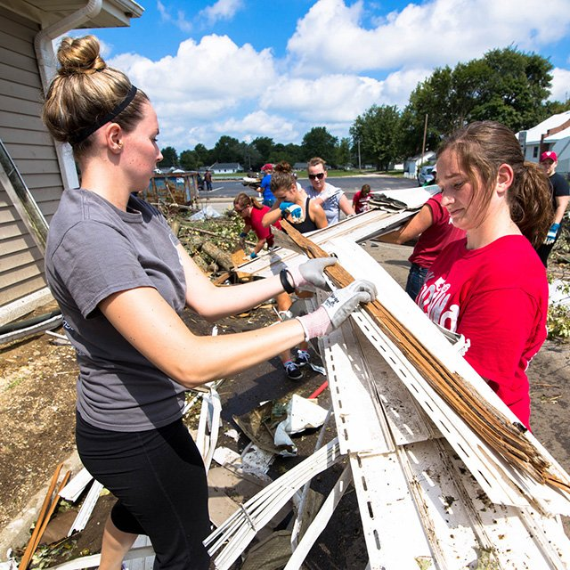

Slide 41
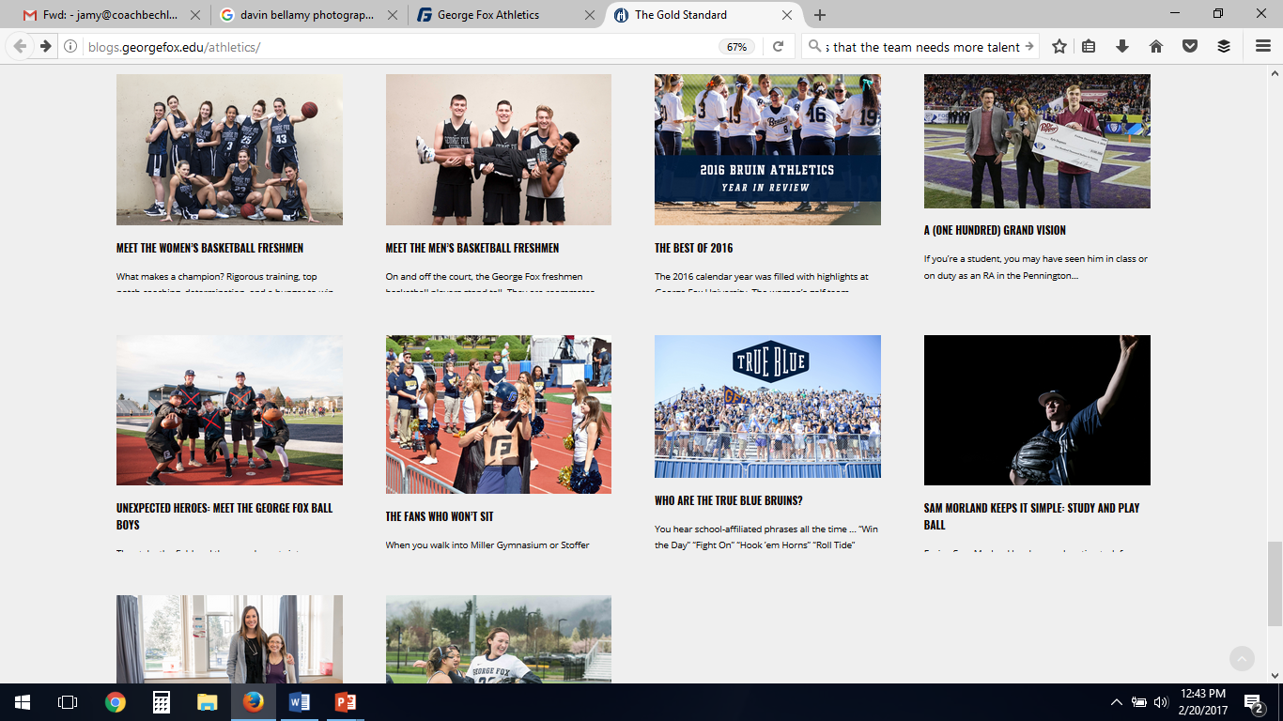

Slide 42
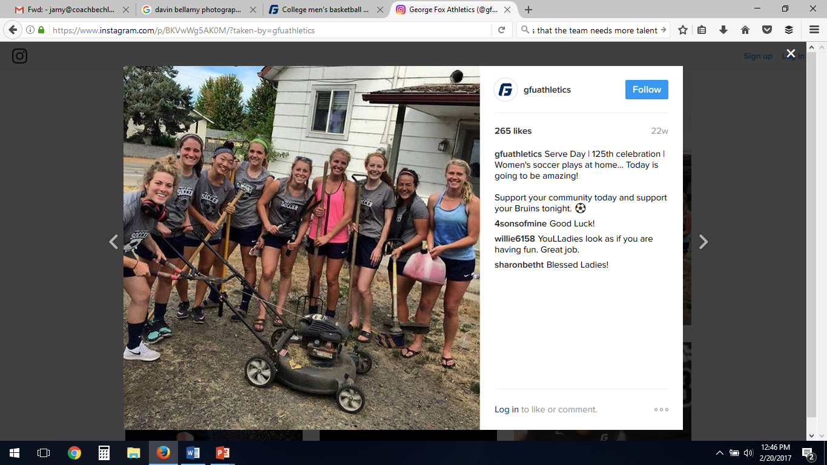

Slide 45
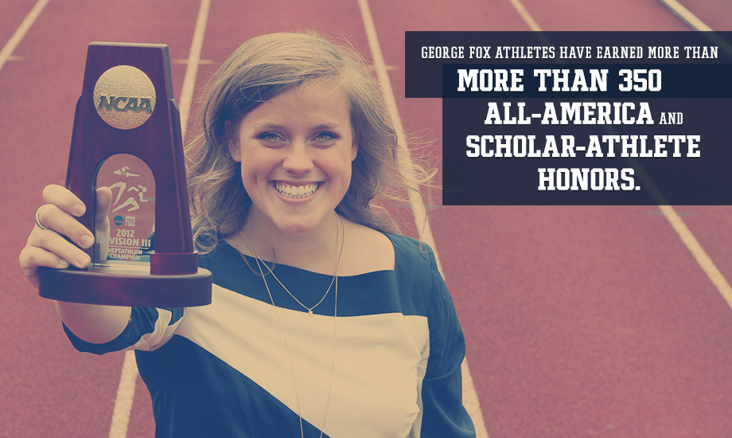
Differentiate Yourself as an Athlete
✓ Leadership
✓ Accountability
✓ Teamwork
✓ Mental Toughness
✓ Time Management
✓ Network and Build Relationships

Slide 46
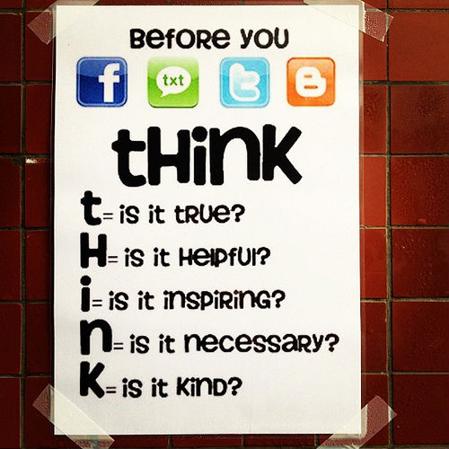

Slide 49
Branding Yourself Through Social Media
JamyBechler.com @CoachBechler

