Slide 1
COLLEGES ARE WATCHING: RECRUITING & SOCIAL MEDIA Branding Yourself Through Social Media
@CoachBechler
Thanks for joining us today. We’ll begin soon. Please leave questions in the chat.

Slide 11
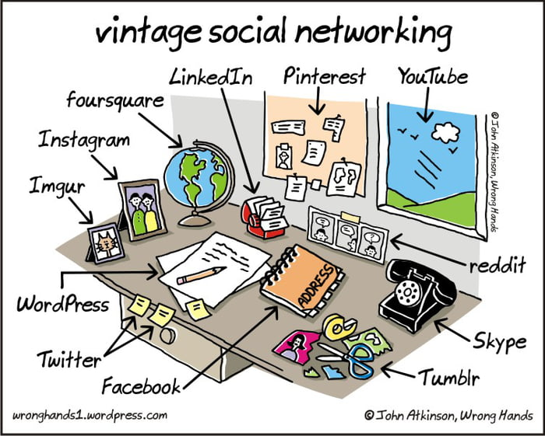

Slide 15
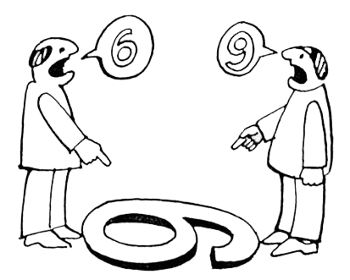

Slide 16
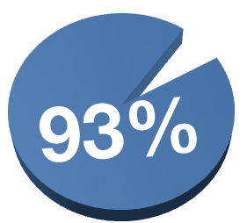

Slide 17
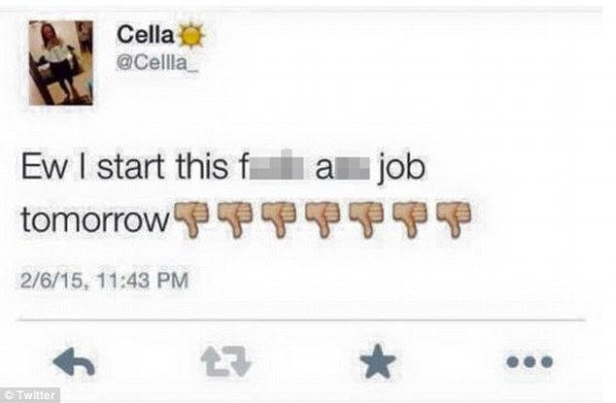

Slide 18
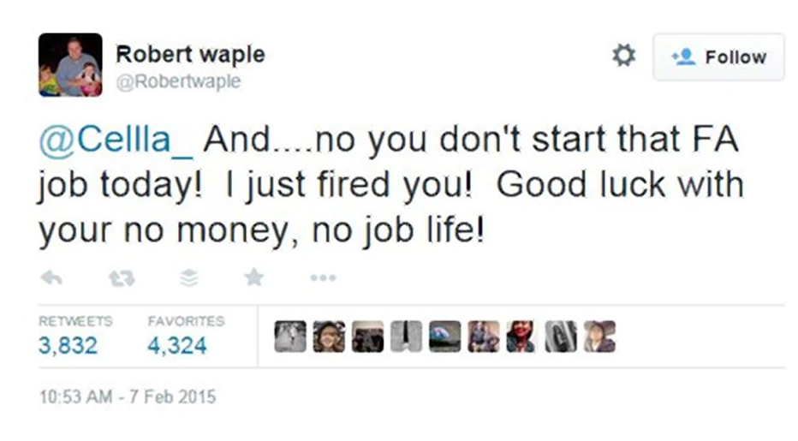

Slide 19
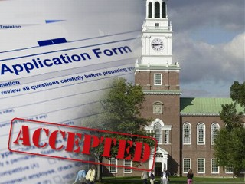

Slide 22
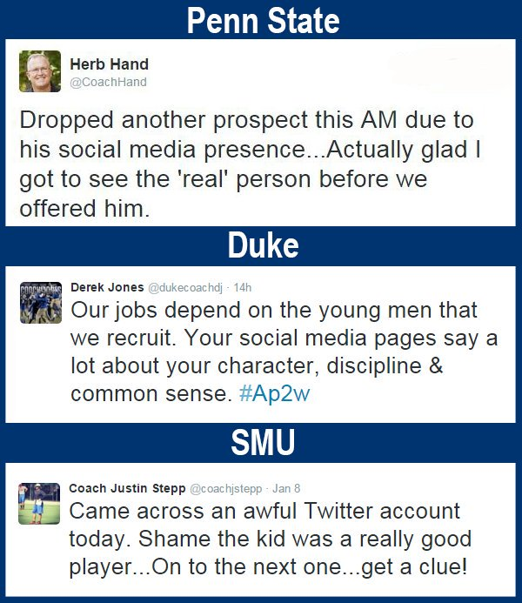

Slide 24
First tweet from the night: @TemberMarchant3: Tonight is gonna be so good. Leggo! Imma be lookin fly as hell! #Holla@me
Next tweet: @TemberMarchant3: Ohhhhh hell yeah. Party started. I got my drink and my 2 step.. Technically my WOP.
2 Tweets later: @TemberMarchant3: Probably the worst night of my life.

Slide 27
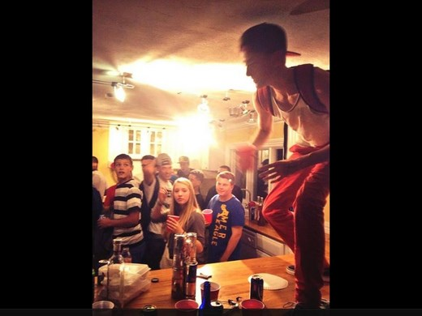

Slide 28
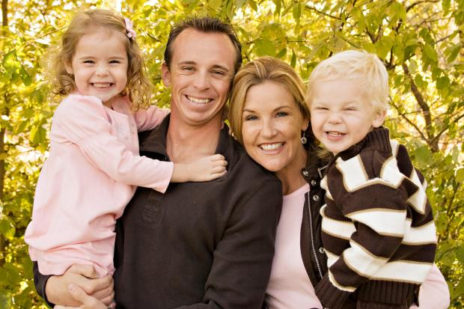

Slide 31
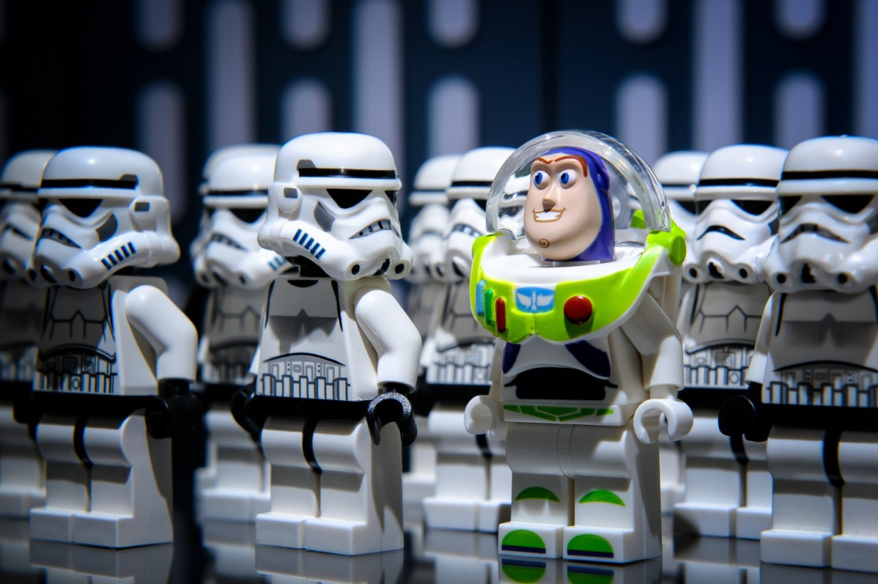

Slide 32
Consistently tell your story
Share your college mission statement and goals.
Identify your glorious moments and success stories.
Demonstrate the importance of team and loyalty to your coaches.
Everything you put on the internet is easily shared and therefore "permanent."
Understand the potential repercussions before sharing your opinions.
Carefully review any photos or videos you plan to post.
Use a communication coach to review your posts before they go live
Support others; Sportsmanship
Say ‘Thank You’

Slide 33
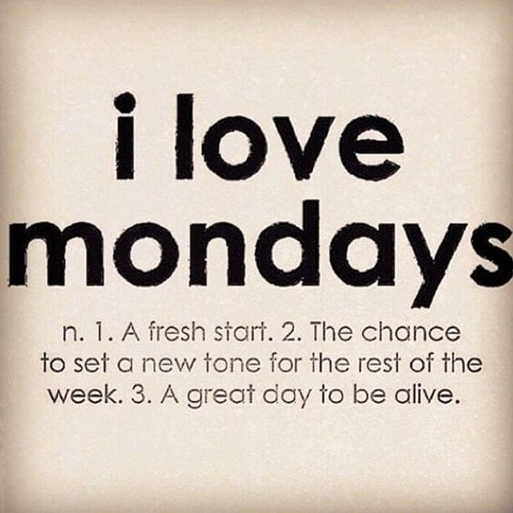

Slide 35
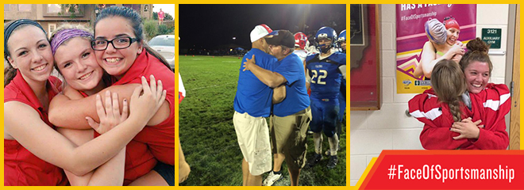

Slide 36
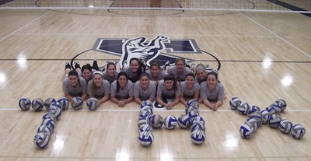
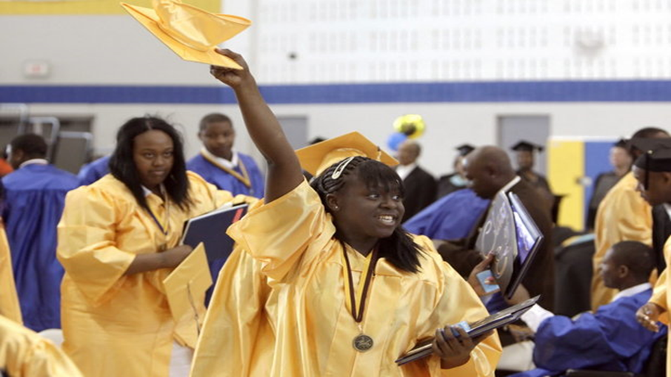
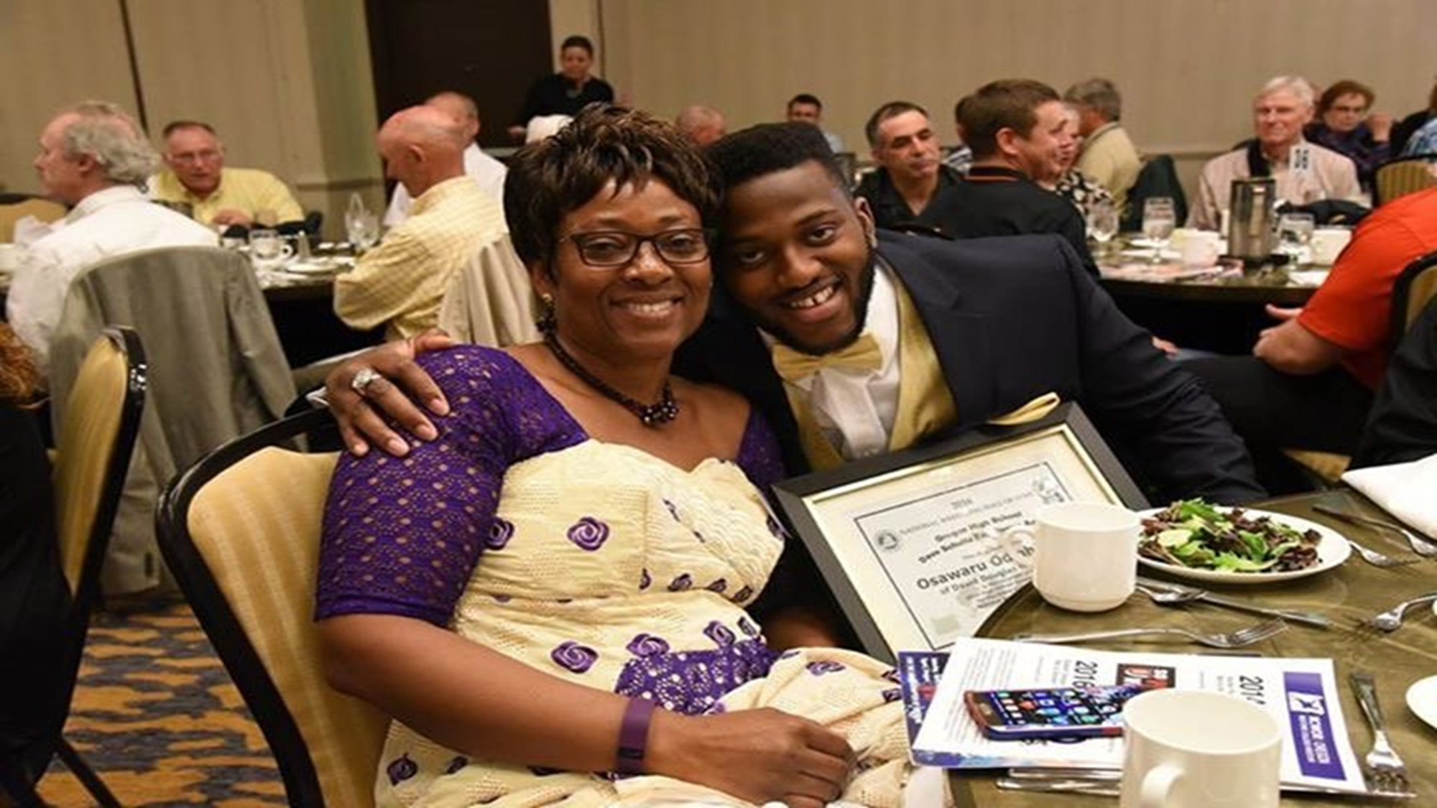
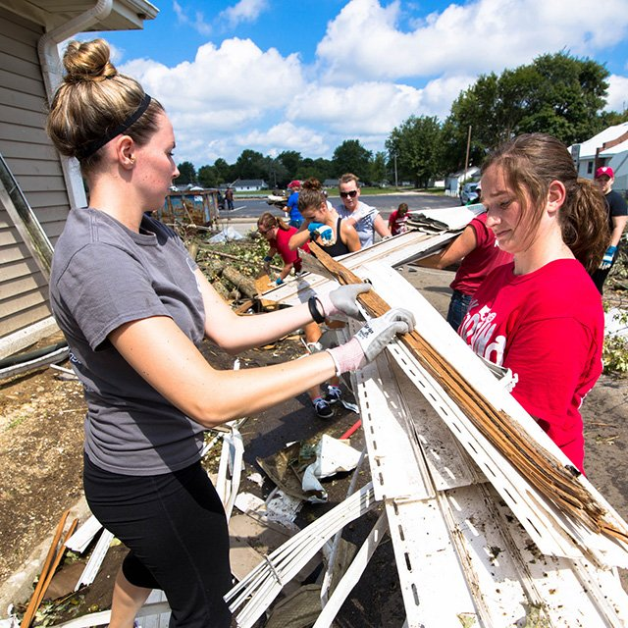

Slide 38
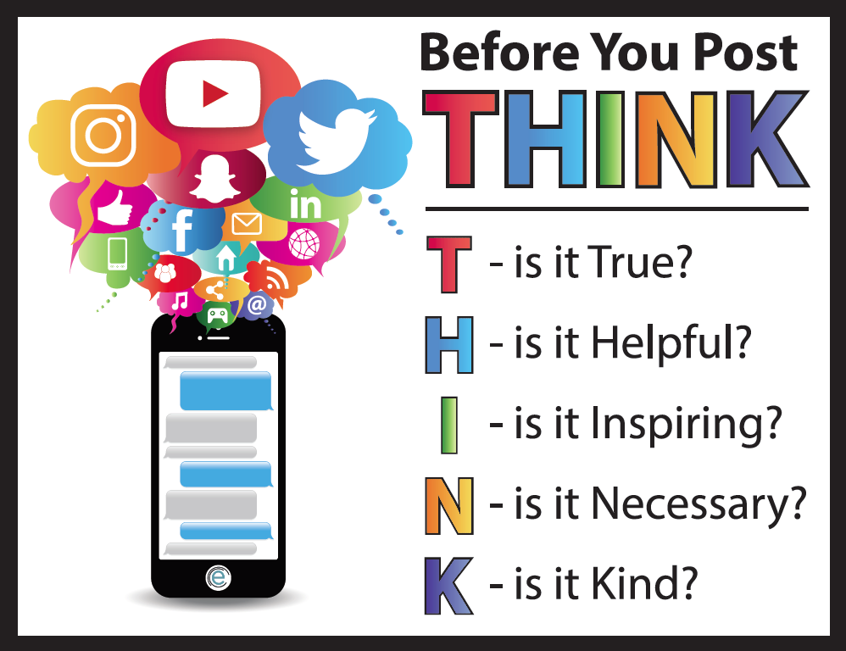

Slide 39
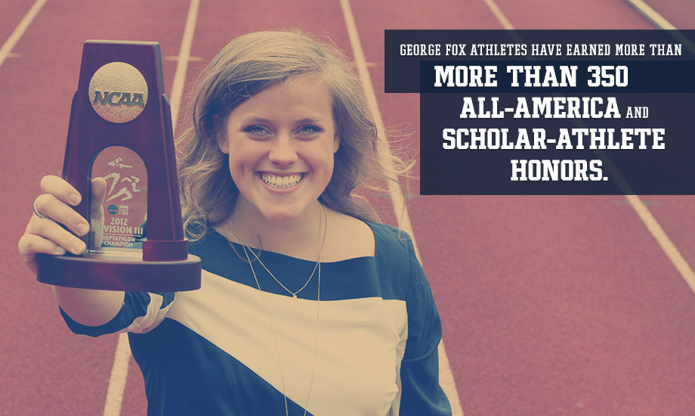
Differentiate Yourself as an Athlete
✓ Leadership
✓ Accountability
✓ Teamwork
✓ Mental Toughness
✓ Time Management
✓ Network and Build Relationships

Slide 40
COLLEGES ARE WATCHING: RECRUITING & SOCIAL MEDIA Branding Yourself Through Social Media
JamyBechler.com/socialmedia @CoachBechler

