Slide 1


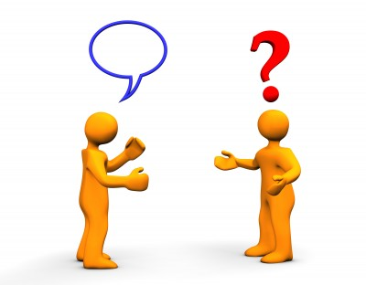




Text “Culture” to 66866 in order to get presentation notes, resources, a special offer, and to register for our drawing (1) free year of TheLeadershipPlaybook.com or (2) books for your coaching staff.
JamyBechler.com
@CoachBechler
JamyBechlerLeadership
(765) 661-2841
jamy@coachbechler.com
“Communicating Effectively with Stakeholders”

Slide 2
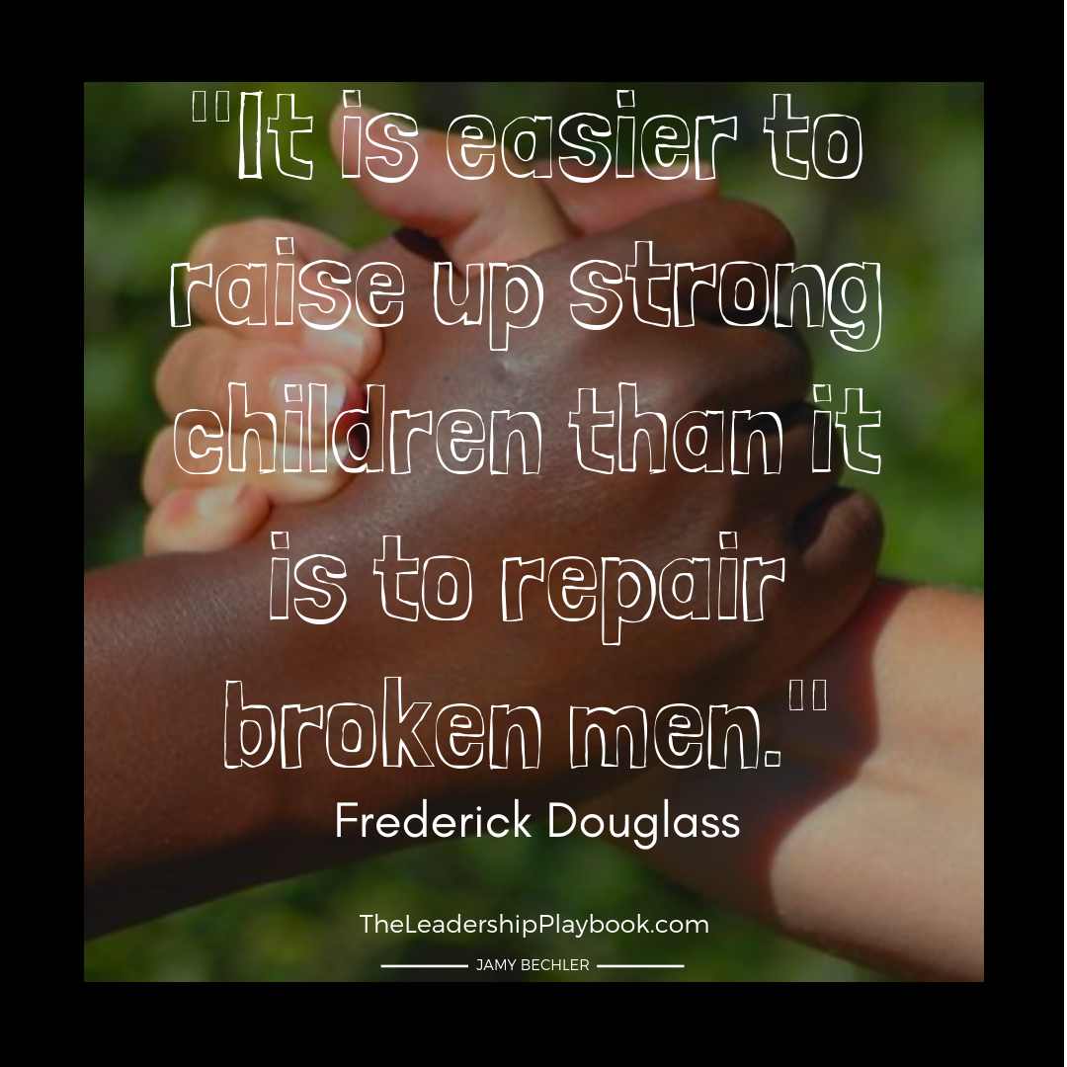

Slide 3


Slide 4

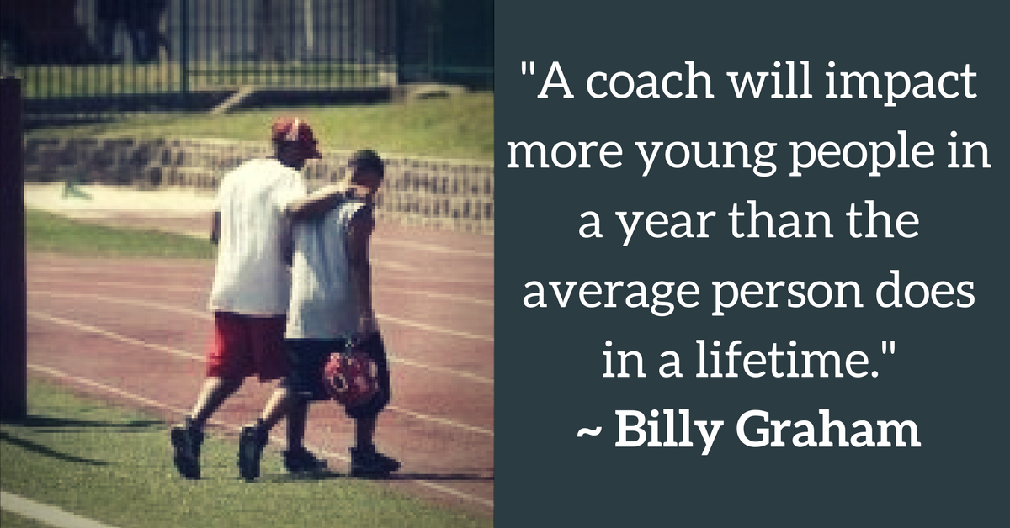

Slide 5


Slide 6
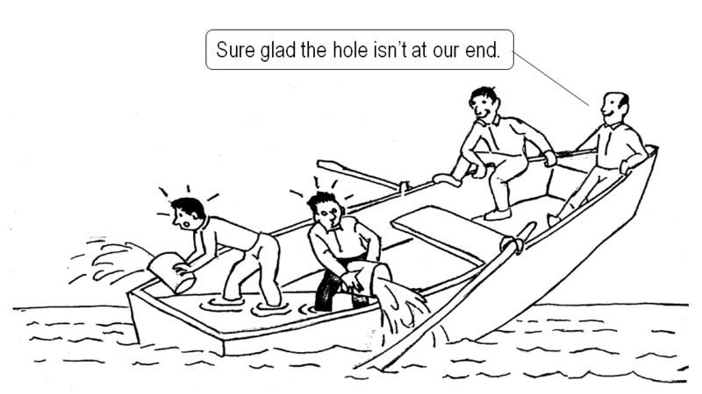

Slide 7


Slide 8

When will people BUY what you’re SELLING?
Know
Like
Trust

Slide 9

7 C’s of
Building Trust
Caring
Credibility
Connection
Consistency
Competency
Commitment
Communication
@CoachBechler

Slide 10
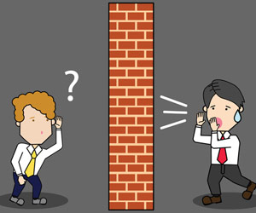
Barriers
?????
@CoachBechler

Slide 11
Barriers to Effective Communication
Lack of connection
Ego - Agenda
Emotional
Distracted
Indifference
Not listening
Not understanding
Assumptions
Not seeing another’s perspective
Arrogance
Only one method and/or not repeating the message
Jargon - Interpretation
One-sided
Tone
Non-Verbals
Lack of credibility
Negativity
Not Listening
Spouse ☺
@CoachBechler

Slide 12
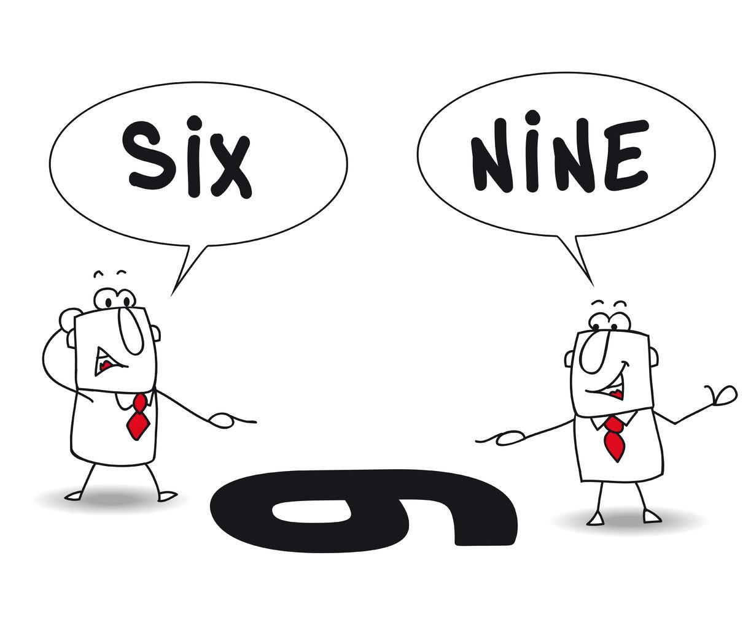
@CoachBechler

Slide 13
Not Understanding
(Perspective)
Barrier to Effective Communication
@CoachBechler

Slide 14


Slide 15
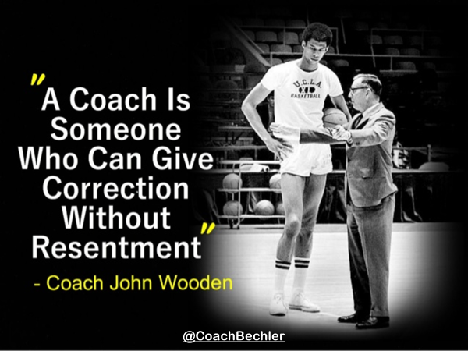

Slide 16
Lack of Connection
Barrier to Effective Communication
@CoachBechler

Slide 17
Negativity
Barrier to Effective Communication
@CoachBechler

Slide 18


Slide 19
Assumption
Barrier to Effective Communication
@CoachBechler

Slide 20
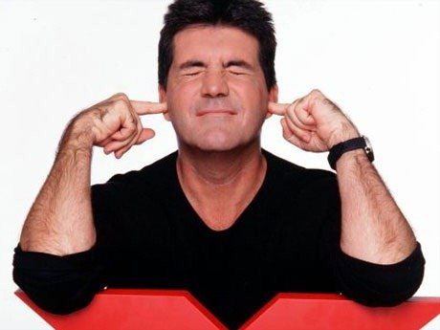

Slide 21
Wrong Tone
Barrier to Effective Communication
@CoachBechler

Slide 22
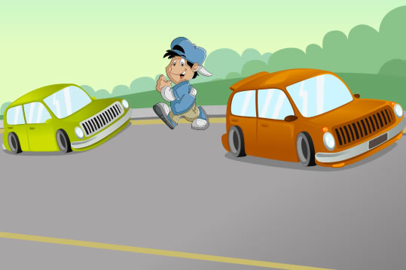
@CoachBechler

Slide 23
Dead Right
(Arrogance)
Barrier to Effective Communication
@CoachBechler

Slide 24

Communication Needs to be…
Correct (True, Accurate)
Positive (Helpful, Productive, Wise)
Relevant (Focused, Necessary, Timely)
Simple (clear to them, concise)
@CoachBechler

Slide 25
What Can You Do?
Activities
Think
Be Proactive
Use their name
Catch them being good
Evaluate, Grow, Improve
Reinforce with repetition and behavior
Self-Awareness
Little moments
Intentionality
Minimize Barriers
Handwritten Notes
Daily Chat Chart
Game Plan/Proper Environment
Social Media
Gives opportunities (officials, committees, huddles, meetings)
Learn to listen; Listen to learn
Equip, Enhance, Empower, Encourage
@CoachBechler

Slide 26
Text “Culture” to 66866 in order to get presentation notes, resources, a special offer, and to register for our drawing (1) free year of TheLeadershipPlaybook.com or (2) books for your coaching staff.
JamyBechler.com
@CoachBechler
JamyBechlerLeadership
(765) 661-2841
jamy@coachbechler.com
“Communicating Effectively with Stakeholders”

Slide 27
